Slide 1
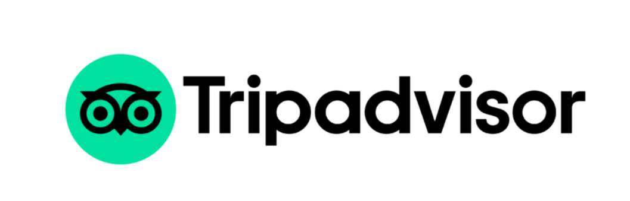
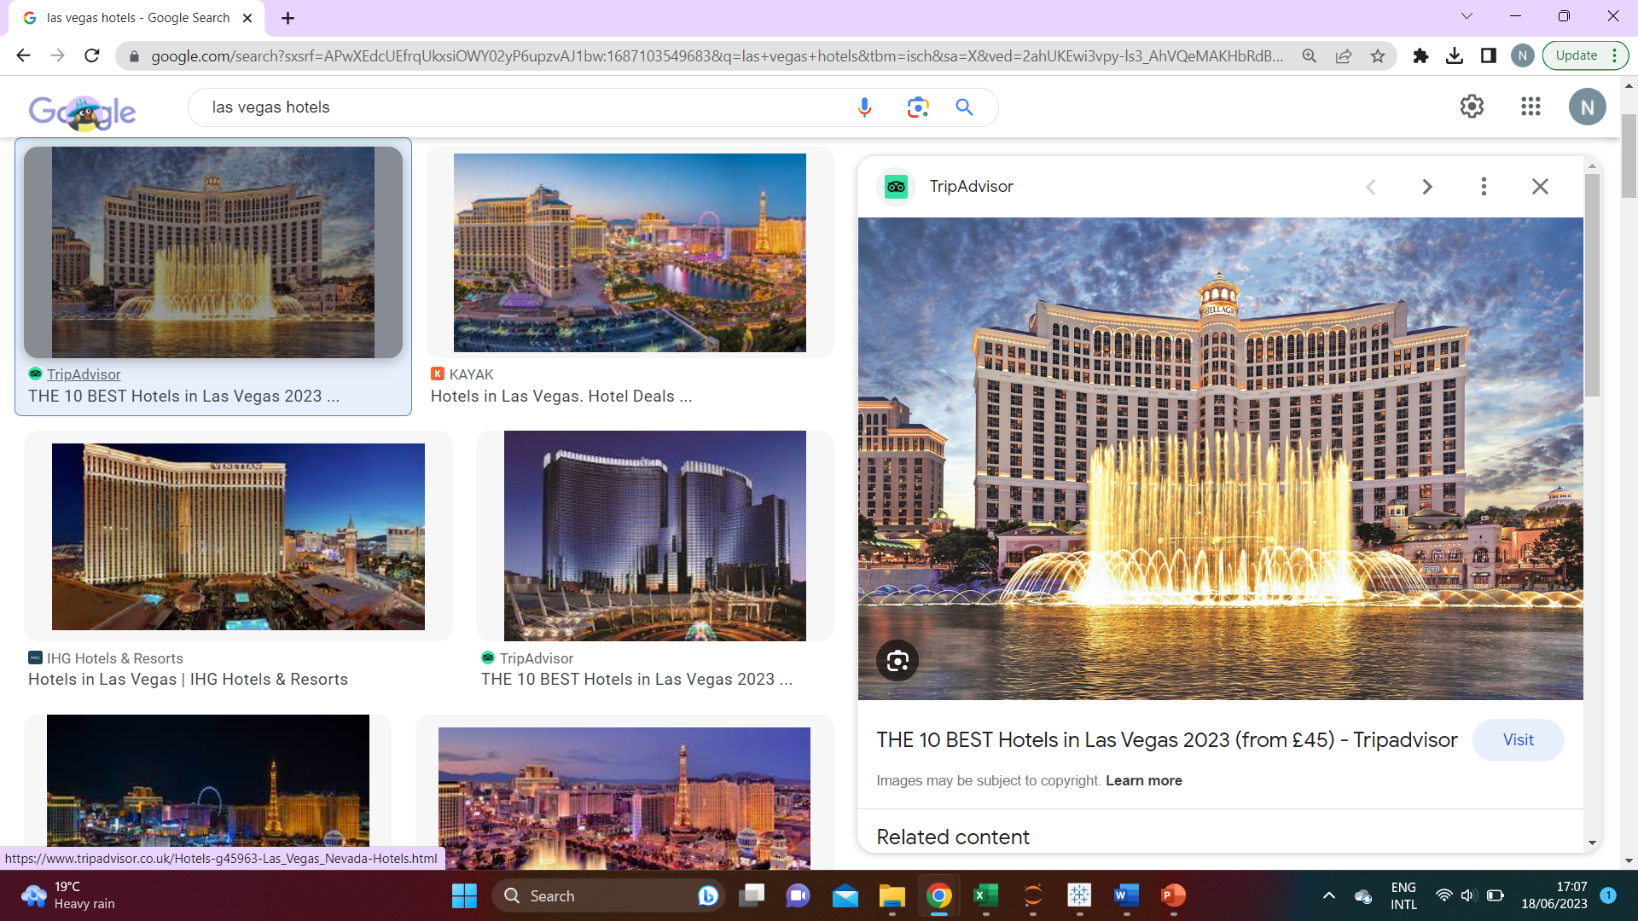
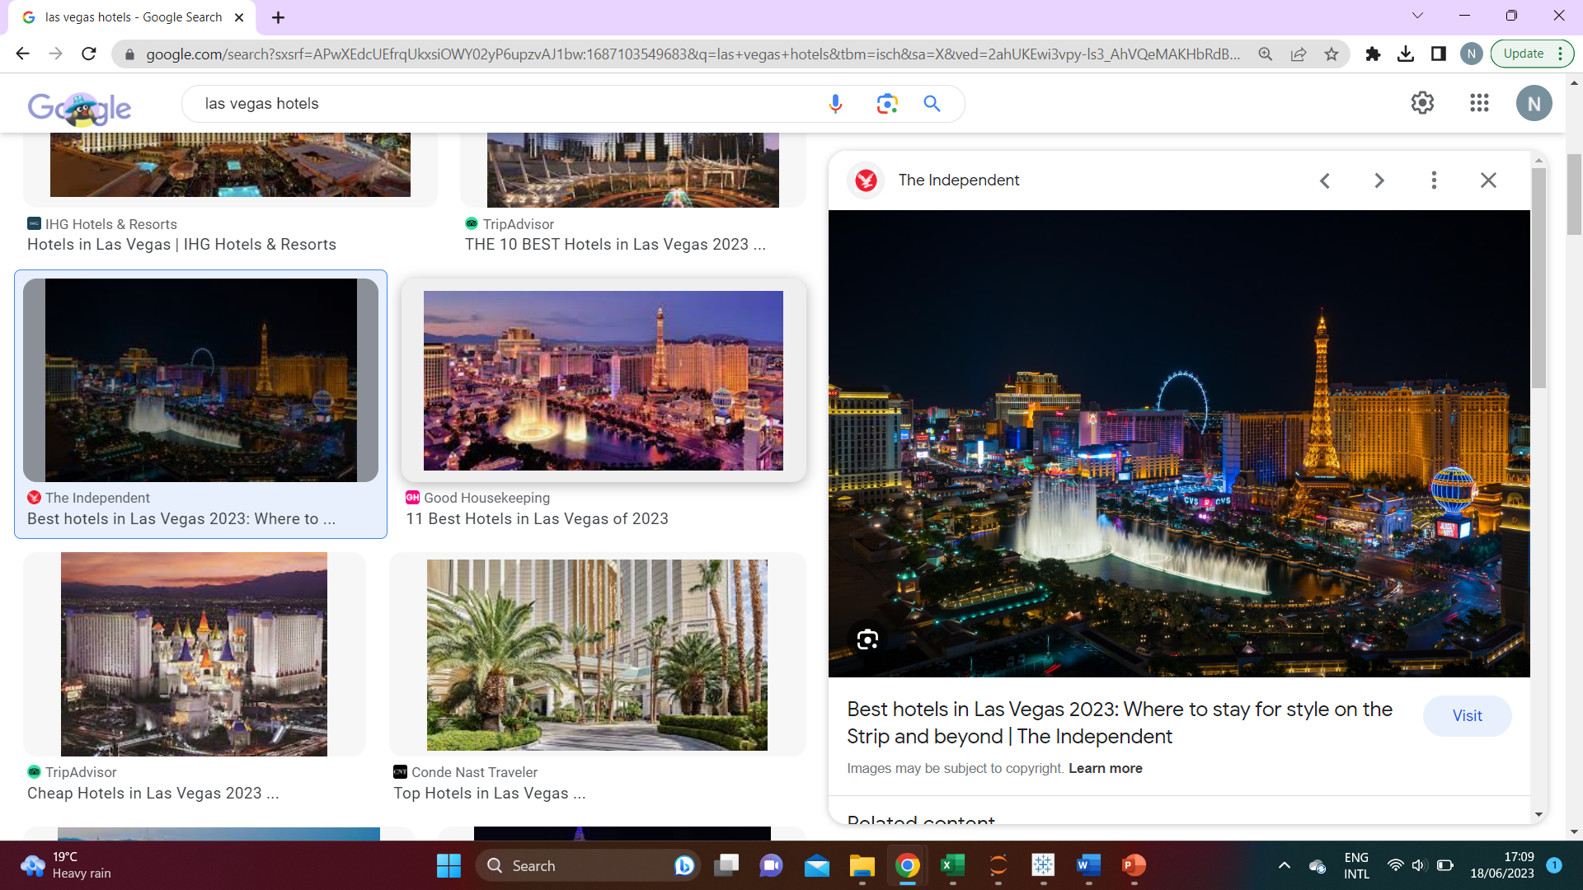
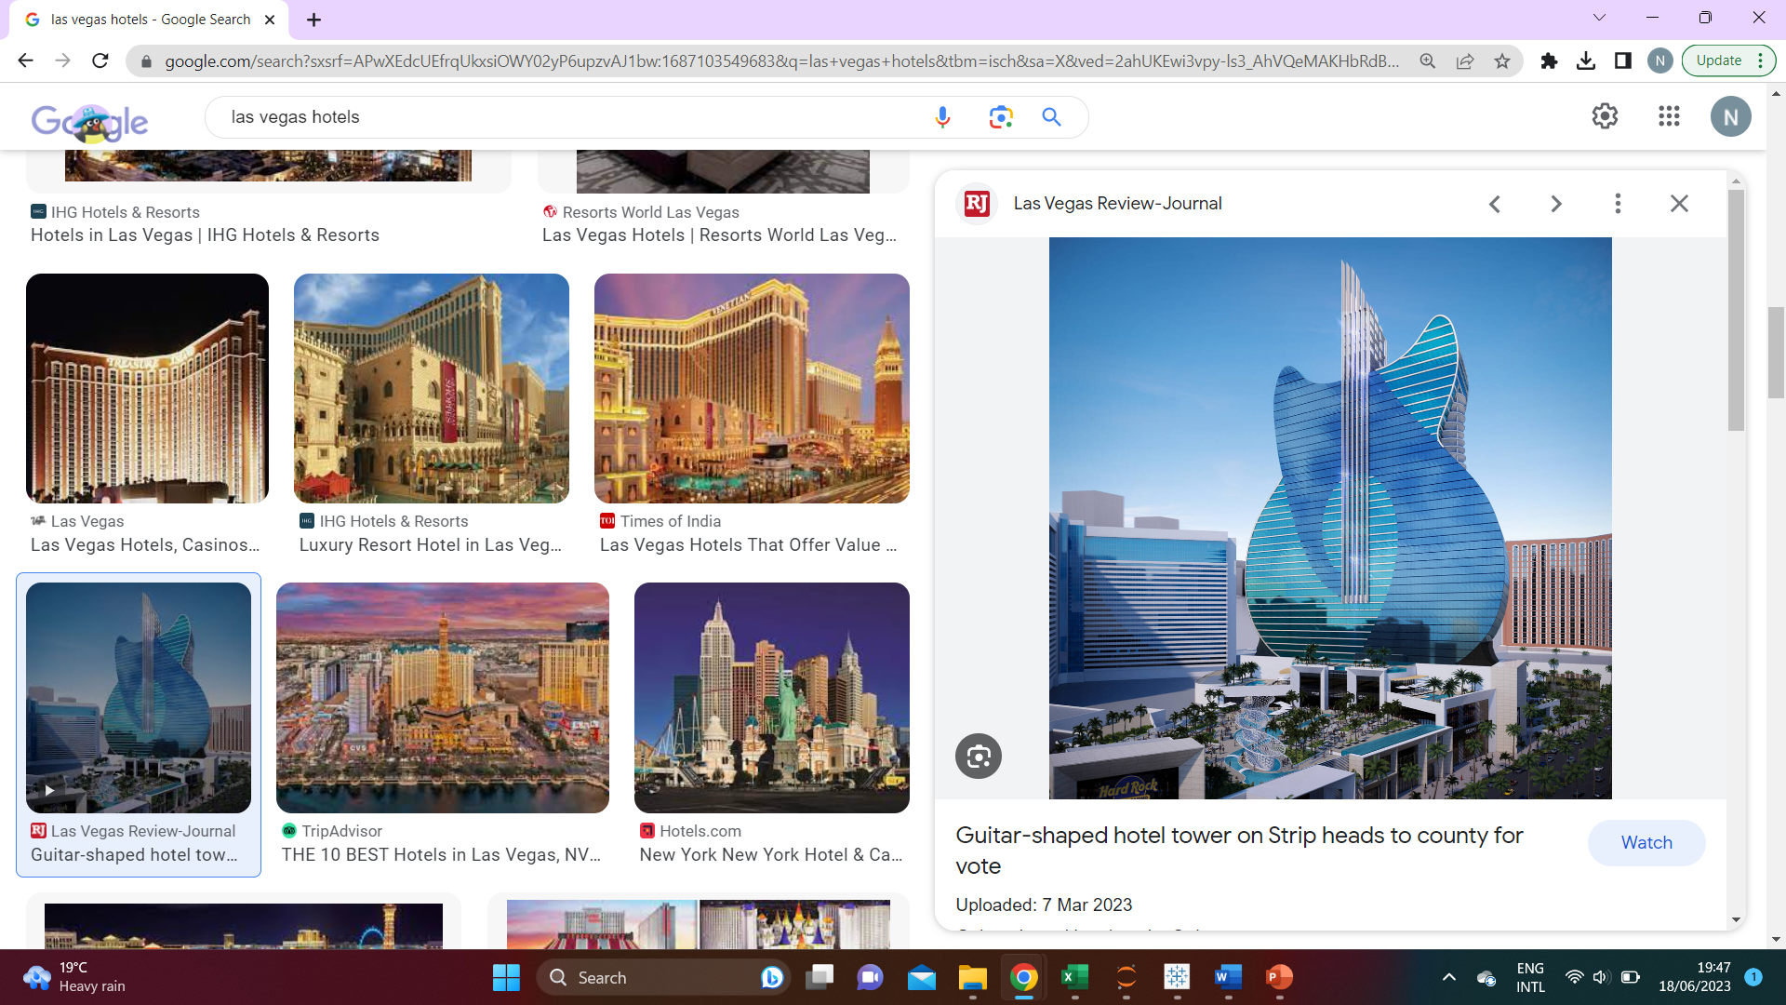
Slide 1
Analysis based on
Las Vegas Strip Hotel Reviews

Slide 2
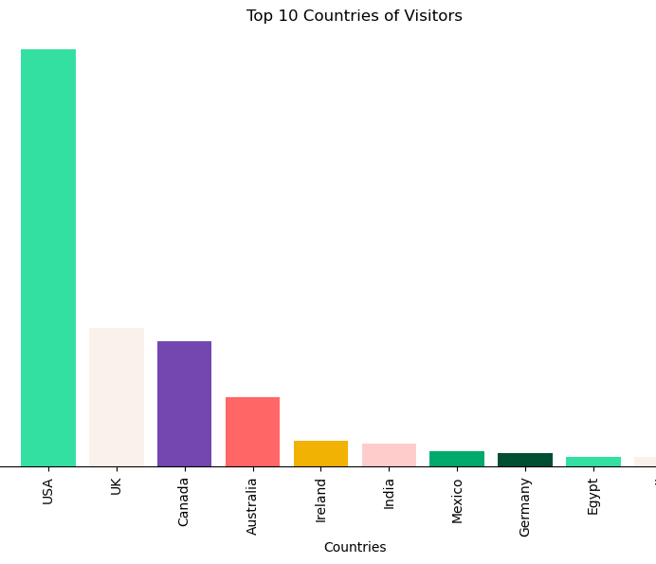
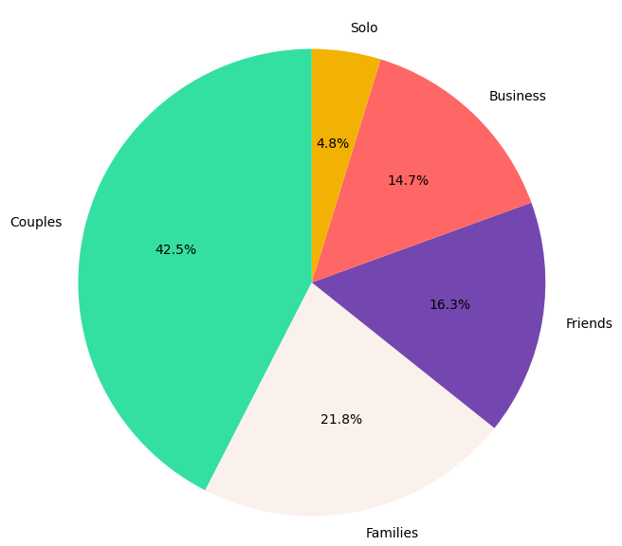
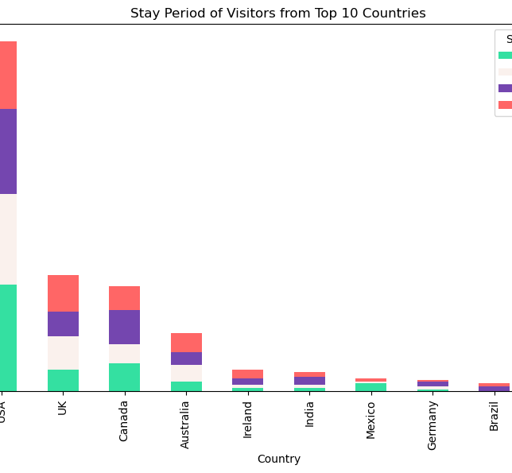
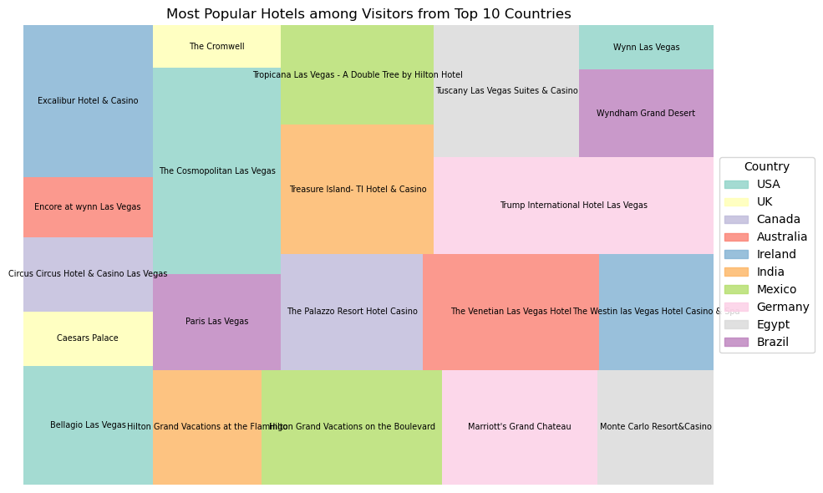
Summary of analysis for marketing purposes
87.4% of visitors were from the Top 10 countries …
42.5% of visitors were Couples
21.8% were Families and 16.3% were Friend groups. Solo travelers were the fewest.
Depending on the focus of the Hotels and platform, different traveler groups can be targeted to either grow the number of guests per traveler type or the size of the traveler type.
Guests from USA far exceed all other guests followed by those from UK and Canada.
This information could be applied in future promotions for Las Vegas.
Stay Period was not indicative
Different countries, different Hotels
With a standard deviation of 1.63 visitors, there was no difference in overall choice of Stay Period. However, among Top 10 countries, most US guests visited in Dec-Feb, UK guests in Sep-Nov, and most Canadian guests visited in Mar- May.
No Stay Period is comparatively more in demand than others which means the Hotels or platform may decide when to run price promotions.
Most US guests stayed at The Cosmopolitan and Bellagio Las Vegas. UK guests preferred Caesars Palace and The Cromwell, while Canadian guests stayed mostly at Circus Circus and The Palazzo Resort Hotel.
This may be due to geo-targeted promotions to the respective locations.

Slide 3
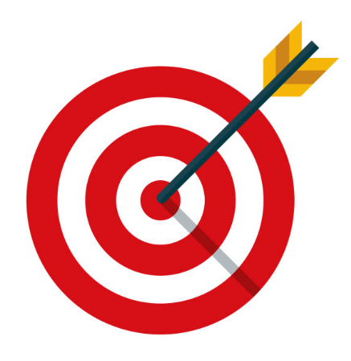

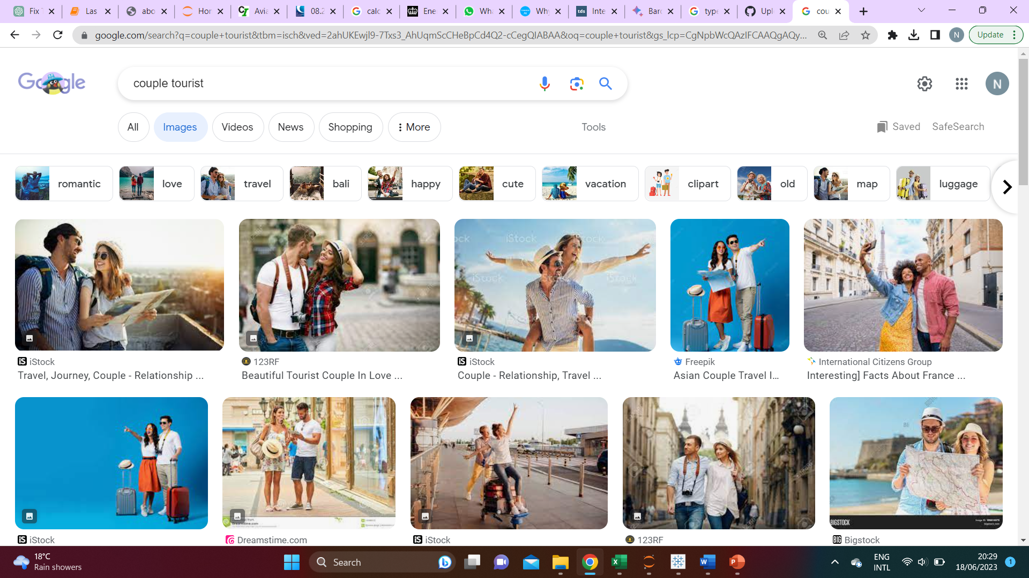

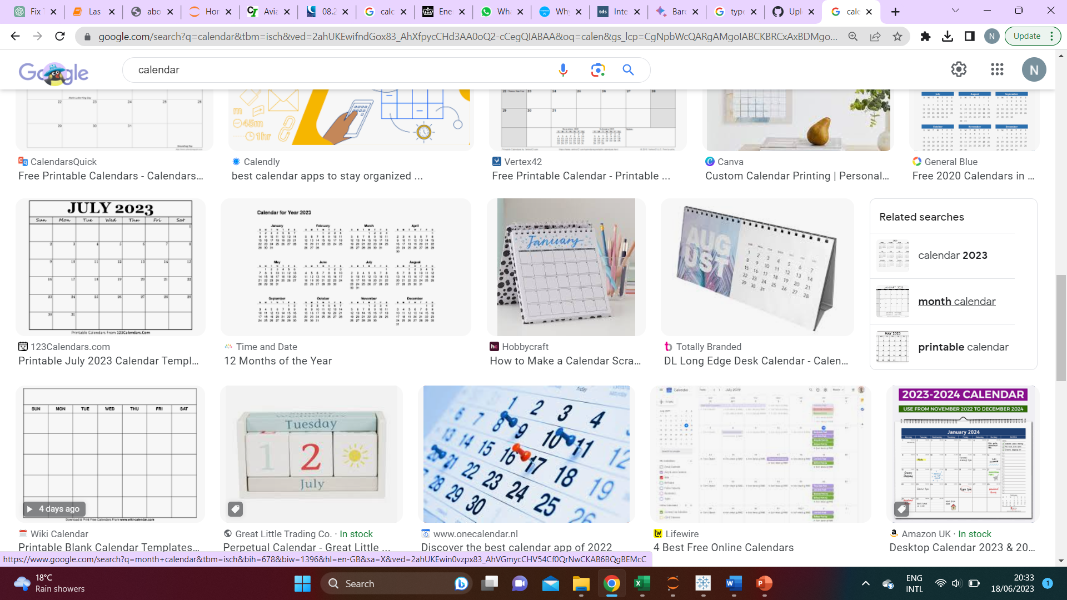
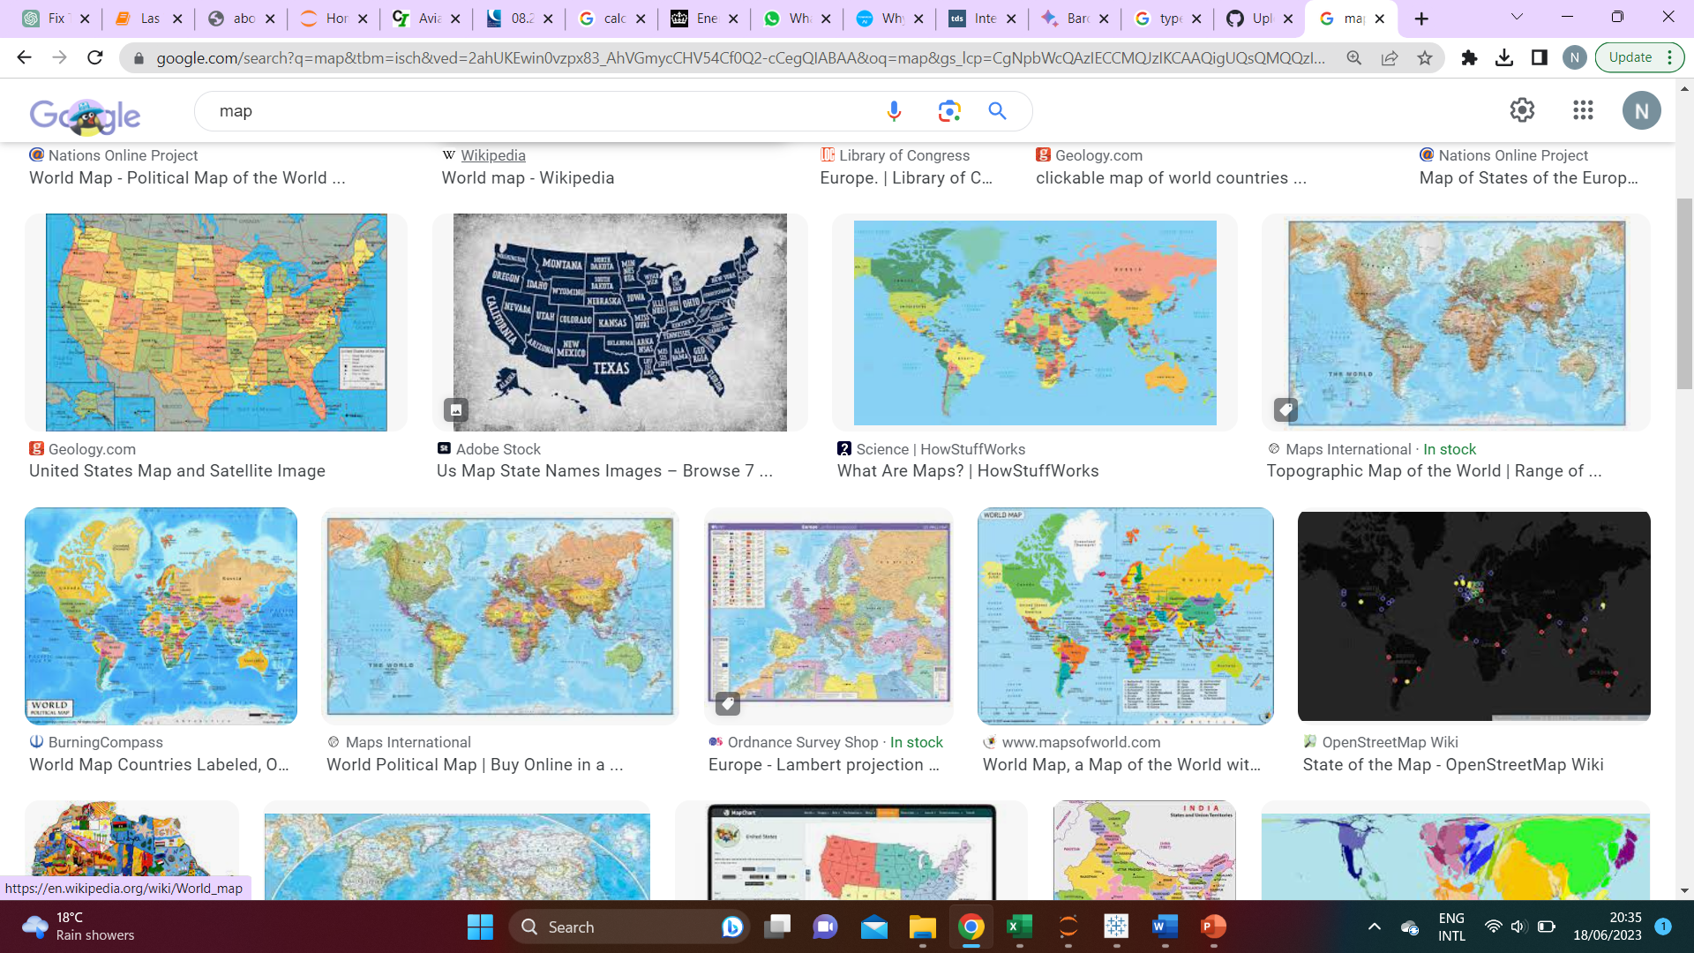
recommendations
Targeted promotions are recommended to drive more visitors across Traveler Types, and to increase guest numbers within the respective Traveler Types
Most visitors were from within the USA
There was no indication that specific Stay Periods are more popular overall.
Overall and among the Top countries, most guests were Couples.
An unproportionate number of guests were from the US, this creates an opportunity to promote the destination to other audiences and geographies
Solo travelers were the lowest population among Traveler Types
The database will enable effective prioritization of resources in the promotion of Las Vegas to TripAdvisor’s global audiences.
Promotions can either be targeted to low performing Traveler Types, such as solo travelers and countries outside of the Top 10, or within the Top 10 and among higher performing Traveler Types like Couples and Families to increase visits.
This information could be used in targeting more domestic customers within the USA to visit Las Vegas. This could increase the visitor base thereby growing revenues for both the Hotels and TripAdvisor.
With a low standard deviation among Stay Periods, the Hotels and TripAdvisor may choose to promote during low- or off-peak seasons in order to increase visits.
Knowing that the primary Traveller type using TripAdvisor to Las Vegas is Couples would help in the creation of marketing material, promotions and cross-marketing across platforms where couples meet or engage. This could help increase the number of visitors within this high-performing segment thereby increasing overall revenue.
After the USA, the next highest population of visitors were from the UK and Canada. As such, there is an opportunity to target customers across other regions to grow member base and increase visits to Las Vegas through TripAdvisor.
There is an opportunity for TripAdvisor to create experiences for Solo Travelers which would help increase the number of visitors from this segment. This information could also help in the effective promotion of such experiences among solo traveller communities to increase uptake and revenue.

